Slide 1
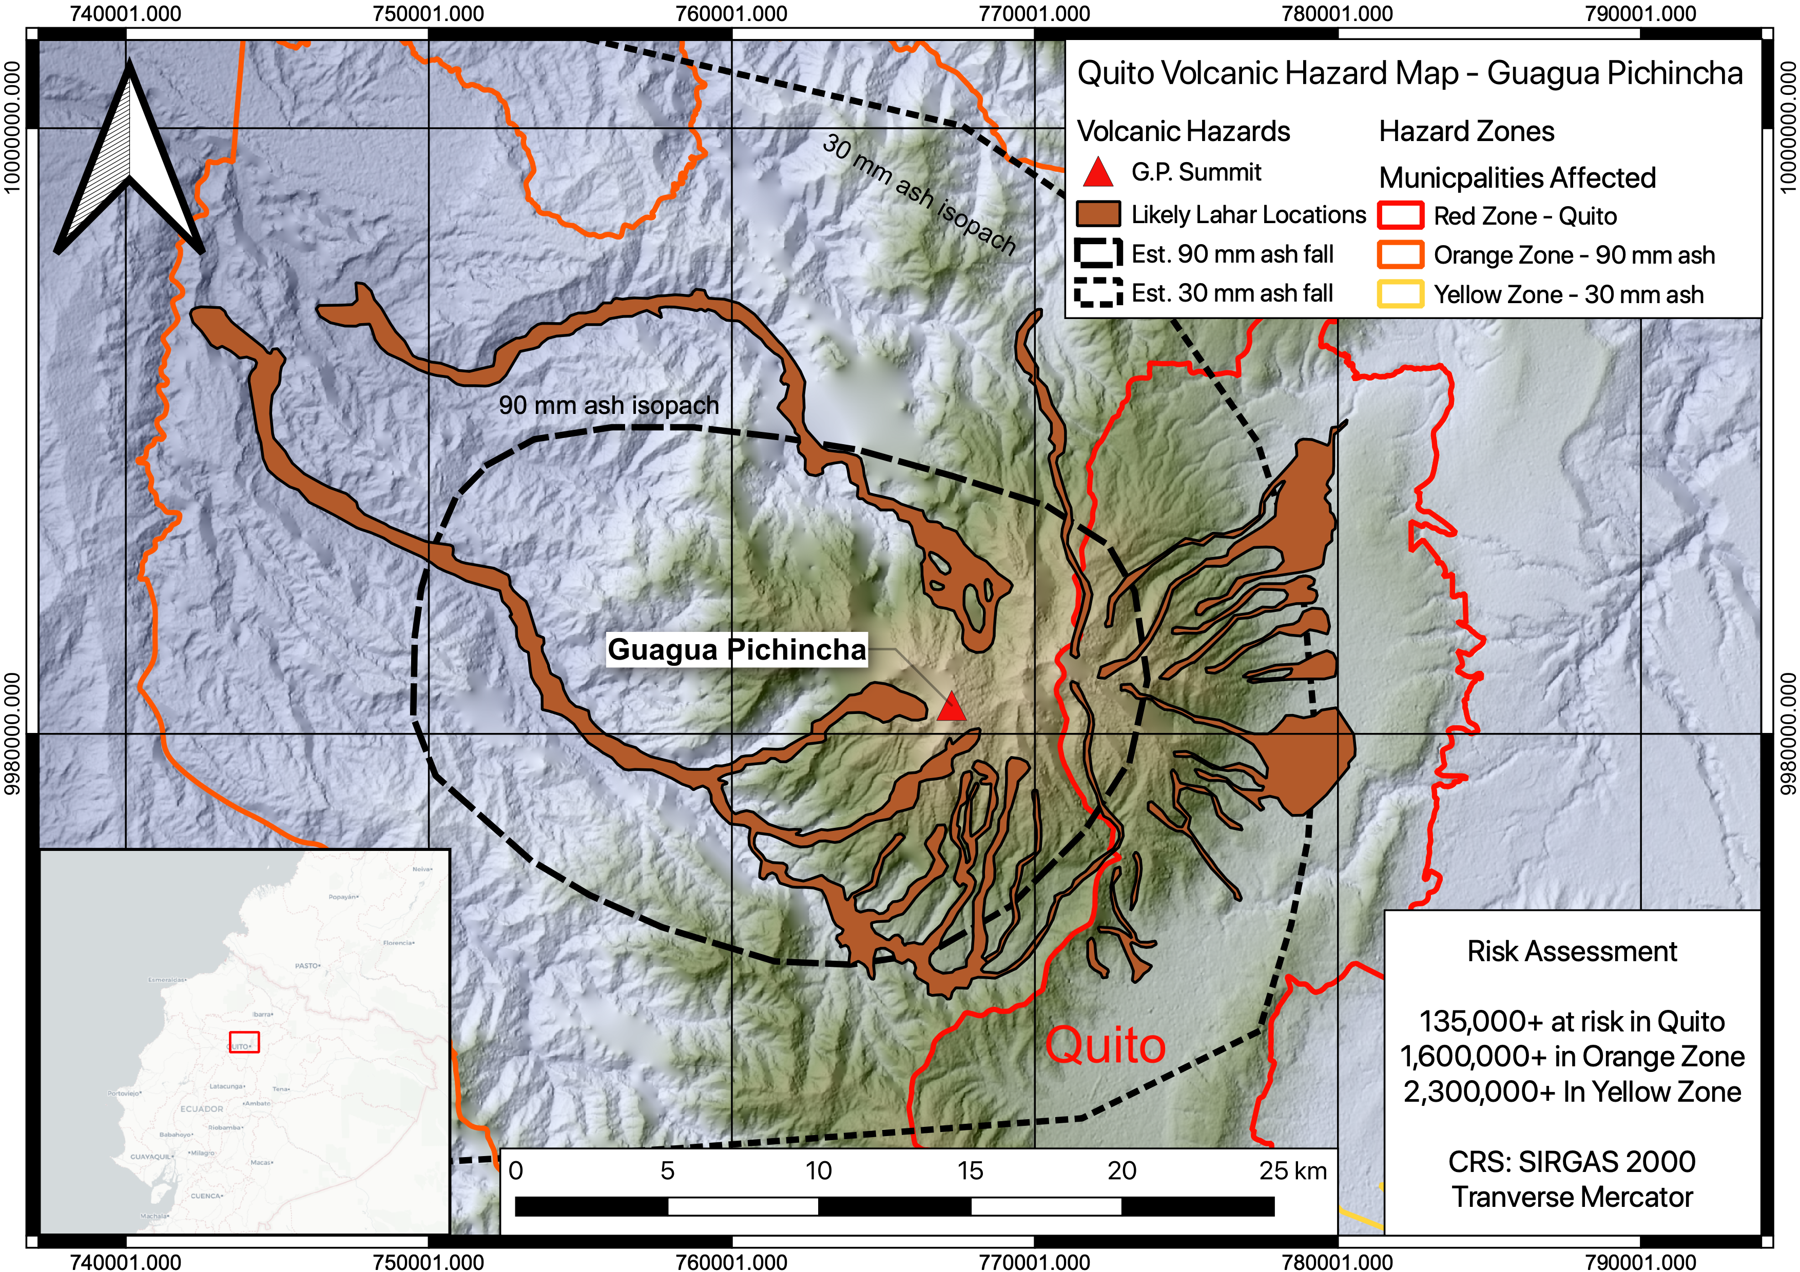
GIS for Geoscientists Session 1: Beginner GIS
Presented by Nicholas Barber, Postdoctoral Researcher at McGill University, QC, Canada.
nicholas.barber2@mcgill.ca | www.volcannick.com | https://github.com/ndb38 | Twitter @volcannick

Slide 2
Course Outline
Tuesday November 1st : Beginner GIS
Course Objectives
Principles of GIS
Tour of the Interface
Projections + Data Types
Managing Layers, Manipulating Data, Designing Your Map
Thursday November 3rd: Exercise #1 - Guagua Pichincha Hazard Assessment
Tuesday November 8th: Intermediate GIS
Getting more out of GIS
Geoprocessing
Spatial Analysis
Data Management
Advanced formatting
Geostatistics
Thursday November 10th: Exercises #2 and #3
Final map assessment due 30/11/22

Slide 3
Couse Resources
All relevant t course material on Moodle. This includes supplementary videos, recordings, readings, and other material.
All data and documentation for this course can be found on the courses' homepage:
https://github.com/ndb38/gis-for-geoscientists

Slide 5
You will be able to make this map!

Slide 6
Objectives
GIS = Geographic Information System
Definition:
“A GIS is a computer-based system to aid
in the collection, maintenance, storage,
analysis, output, and distribution of spatial
data and information.” – Paul Bolstad (GIS Fundamentals)

Slide 7
My goals over the next few weeks
Highlight what GIS can do
Outline the key principles of a geographic information system
Providing a fully guided GIS workflow template
Identify key areas where GIS can hep you with your research/career

Slide 8
If you take nothing else away from this course….
GIS is a helpful tool in your workflow if you have data with a spatial dimension
GIS software lets you store, collect, analyze, and share data
Modern GIS platforms like ArcMap and QGIS are all around workhorses – essential to tasks like spatial modeling, database management, cartography, geodesy, data visualization, hazard mitigation, and story telling
Learning the capabilities of GIS is acquired from repeated trial and error with the hundreds of built-in tools
Studies should be designed with the GIS end user in mind!!!

Slide 9
Outline of today’s class
The Rules of GIS
Planning a project
Finding Data
Defining CRS/PCS
Initial Import + Projection
Georeferencing Images
Tracing Basemaps
Analysis: Geoprocessing, Statistics, Attributes
Visualization and Symbology***
Layout Design***

Slide 10
Principles of GIS
Organization→ Projections → Data Types → Errors → Layout → Software

Slide 11
Data Management
GIS data is diffuse, found in about 1000 different repositories
Governmental
Nonprofit
Educational
Research
Individual papers
Consortiums
Private
File structure complex – one elevation dataset may have 6+ individual files, that all get compiled upon use in software
File size can be massive: my master elevation dataset for Western India is several gigabytes!
In a GIS software, proliferation of “layers” mandates good naming schemes, efficient data storage, and logical file structure

Slide 12
“Rules of GIS” Rule #1: Pick a naming scheme, file structure, data format that suits you. Keep it consistent and document every choice you make throughout a project!

Slide 13
Coordinates & Projections
We use coordinates to define the “where” on a map
Easting and Northing
X and Y
Latitude and Longitude
However, defining where something is may not be straightforward
Maps are a flat surface, and the earth is 3D. There is inherently distortion converting coordinates from 3D to 2D
Need to consider that the Earth is not a sphere
Error in spatial measurements
Physical location of an object changes through time

Slide 14
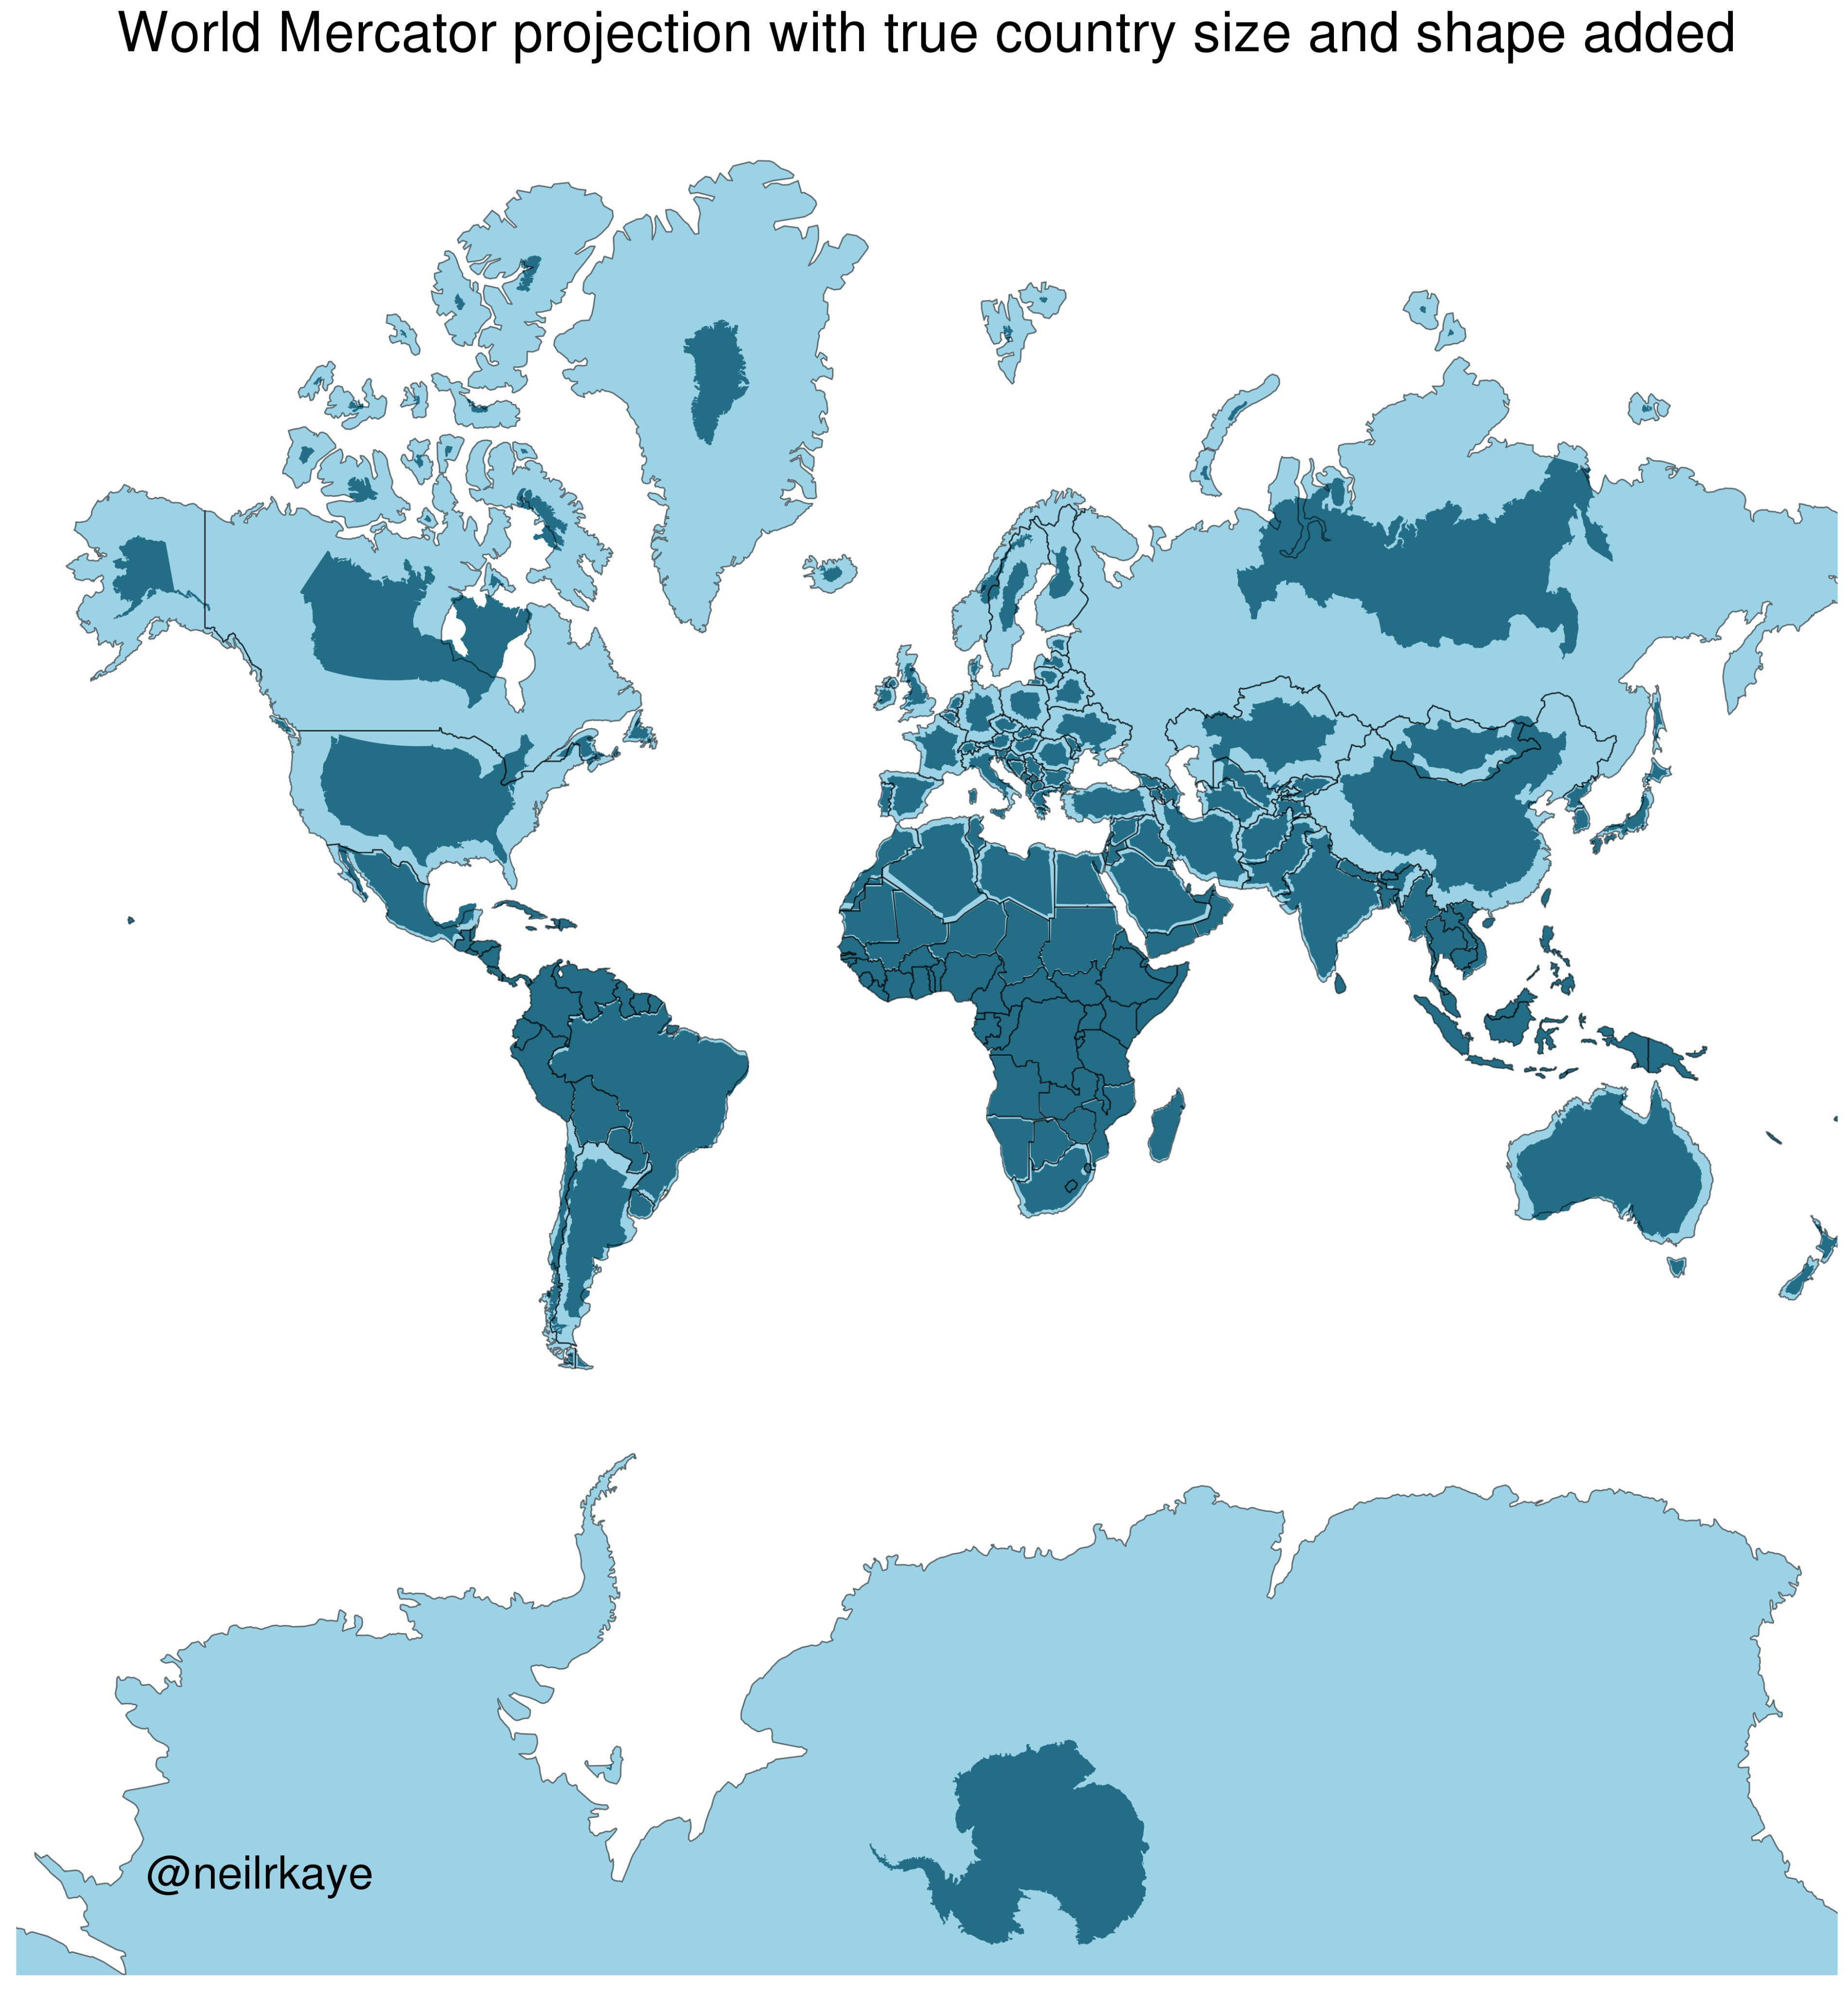

Slide 15
Rule #2 : Known your coordinate system and make every layer in a project use the same system. This needs to be done prior to any analysis!!

Slide 16
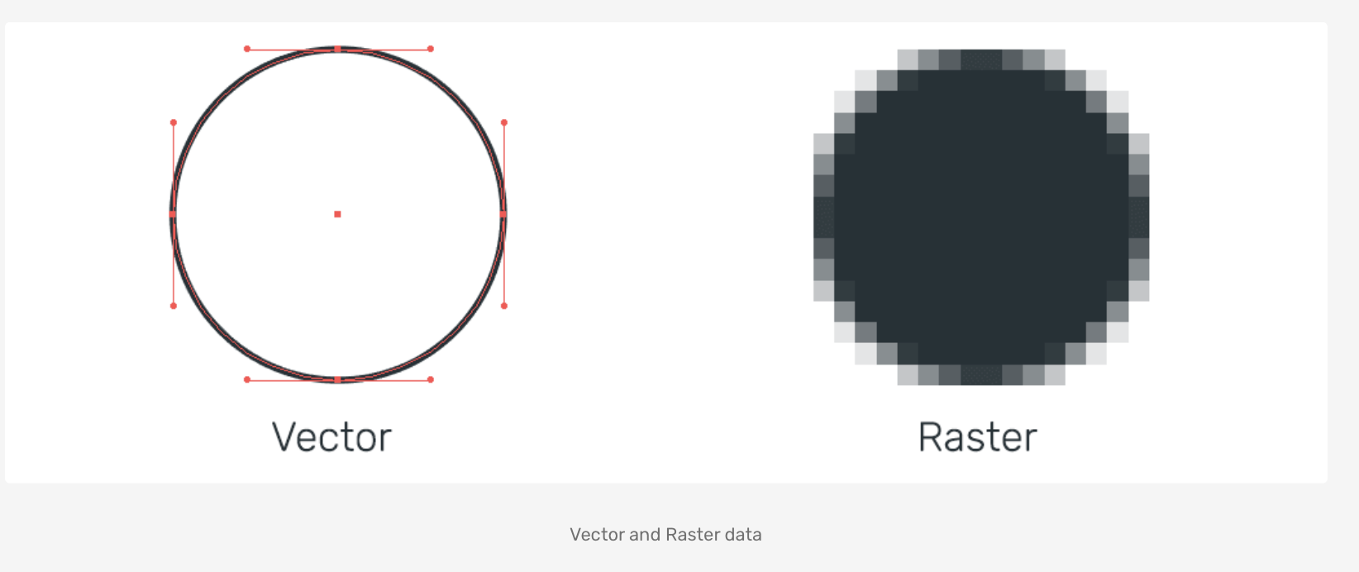
Data Types
VECTOR DATA
Essentially, a spreadsheet that is visualized by a geometry
Geometries include Point, Line, Polygon, Multiline, Multishape, etc.
Common format: Shapefile (.shp), Geopackage (.gpkg), File Geodatabase, KML, CSV, GeoJSON
Relevant data stored in an ATTRIBUTE TABLE
RASTER DATA
Digital image, with data stored in discrete cells of a specific resolution & spectral value
Efficient way to store and present large amount of data
Common formats: GeoTIFF, ESRI Grid, GDAL VRT, etc.
Common uses: Elevation, satellite data

Slide 17
Rule #3 : Design a project with these data types and constraints in mind!

Slide 18
Errors
Sources of error abound in a GIS:
Accuracy of datum and projection system
Positional accuracy of data
Measurement accuracy
Map Scale accuracy
Tied to original scale at which data was mapped, not the scale at which you do the analyses
Quantitative accuracy of attribute data
Conceptual accuracy
How accurate it is it to cluster features into different groups?
Knowledge of User
“Human Error”
For example: estimated error introduced by manually tracing geological boundary in a GIS

Slide 19
Rule #4 : Enumerate error sources at the start of a project, and document error + error propagation as you go!

Slide 20
Layout + Design
Aesthetic choices when presenting your work are scientific decisions. Also a form of data!
Color scheme
Scales
What you chose to show vs. what you didn’t
How much detail do you give your reader?
What kind of message are you sending your audience?

Slide 21

“Not only is it easy to lie with maps, it’s essential. To portray meaningful relationships for a complex, three-dimensional world on a flat sheet of paper or a screen, a map must distort reality.” – M. Monmonier
Need to ask yourself: How am I distorting reality when making this map?

Slide 22
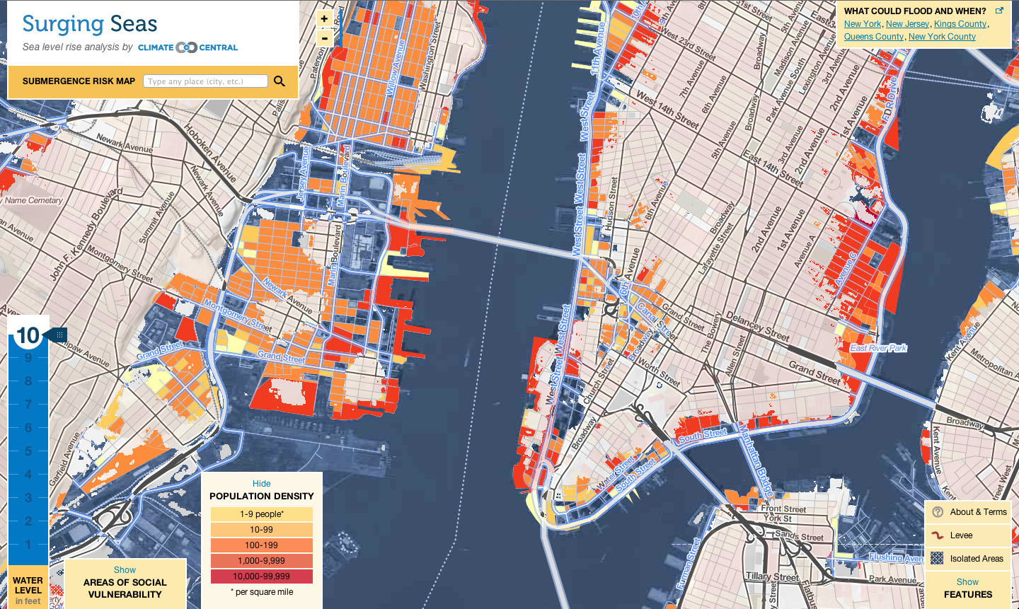
Essential, and one of the most challenging/impenetrable aspects of GIS
Based on principles of design + cartography. Need visualization to be as elegant as it is accurate
Remember data reusability! Underlying data accessible and well documented

Slide 23
Rule #5 : Design is as important as the data– treat any GIS output as you would any figure in a paper!

Slide 24


Software: The Two Juggernauts
ESRI’s ArcMap
Quantum GIS (QGIS)
Proprietary & Industry Standard
The Gold Standard
Comes with a range of products, like Story Maps, ArcGIS Online, Customer support, 3D Viz, other Advanced tools
Data formats are often proprietary and closed-source
Algorithms + data structure can be opaque and hard to reference
Open source, community driven
Not as feature rich but a fast-rising competitor to Arc
Integrated with other open source projects like SAGA, GDAL, Python, PostGreSQL, GRASS GIS, etc.
Can read/process almost any data type
Interface can be clunky
Software dependency issues
UC GIS for Geoscientists- Session 1 - GIS
Presented by N.D. Barber (CMcGill)
nicholas.barber2@mcgill.ca

Slide 25
Software: The Two Juggernauts
ESRI’s ArcMap
Quantum GIS (QGIS)
Proprietary & Industry Standard
In use for Decades
Comes with a range of products, like Story Maps, ArcGIS Online, Customer support, 3D Viz, other Advanced tools
Data formats are often proprietary and closed-source
Algorithms + data structure can be opaque and hard to reference
When not academically affiliated costs $$
Open source, community driven
Not as feature rich but a fast-rising competitor to Arc
Integrated with other open source projects like SAGA, GDAL, Python, PostGreSQL, GRASS GIS, etc.
Can read/process almost any data type
Interface can be clunky
Software dependency issues
UC GIS for Geoscientists- Session 1 - GIS
Presented by N.D. Barber (CMcGill)
nicholas.barber2@mcgill.ca

Slide 26
Rule #6 : Keep in mind the audiences and limitations of each software. Make your software choice early, and stick with it!

Slide 27
On to the real thing!

Slide 28
Making a Plan

Slide 29
Planning a QGIS Project
Need to think critically about where GIS fits in to your workflow
A few questions to ask yourself:
What stage of my project am I in? And what value would GIS analyses add at different stages?
E.g., in the planning stage, you might want a map and some prospect sites for outcrops. But in the analysis stage, you might want some specific spatial information about your study site
What question am I trying to answer?
Can this question be answered through other means?
Is there data available for this? (short answer: YES)
More important question: Where is the data I need??
What steps do I need to take to answer this question?
What coordinate/projection system should I use?
How am I going to organize my data?

Slide 30
Our Exercise Today
Focusing on Guagua Pichincha (GP), an active volcano adjacent to Ecuador’s capitol, Quito in the Andes
Our question: How many people are at risk of exposure to the different eruptive products of Guagua Pichincha Quito?
This question encompasses two hazards: 1) lahars (volcanic mudflows) and 2) ash fall
I selected this question for a few reasons:
Require datasets that are readily accessibly
Results verifiable based on previous research
Analyses straightforward, but encompass the crucial “GIS Toolkit” you’ll get out of this course

Slide 31
Importing + Reprojecting Data

Slide 32
Importing Data
Format: SHP, GPKG, GeoTiff
Which layers to keep?
Renaming and resaving
Data specific tasks:
Vector Data: Metadata
Elevation data: Close Gaps + Hillshade
CSV: Import
Reprojection

Slide 33
Deciding on Coordinates and Projections

Slide 34
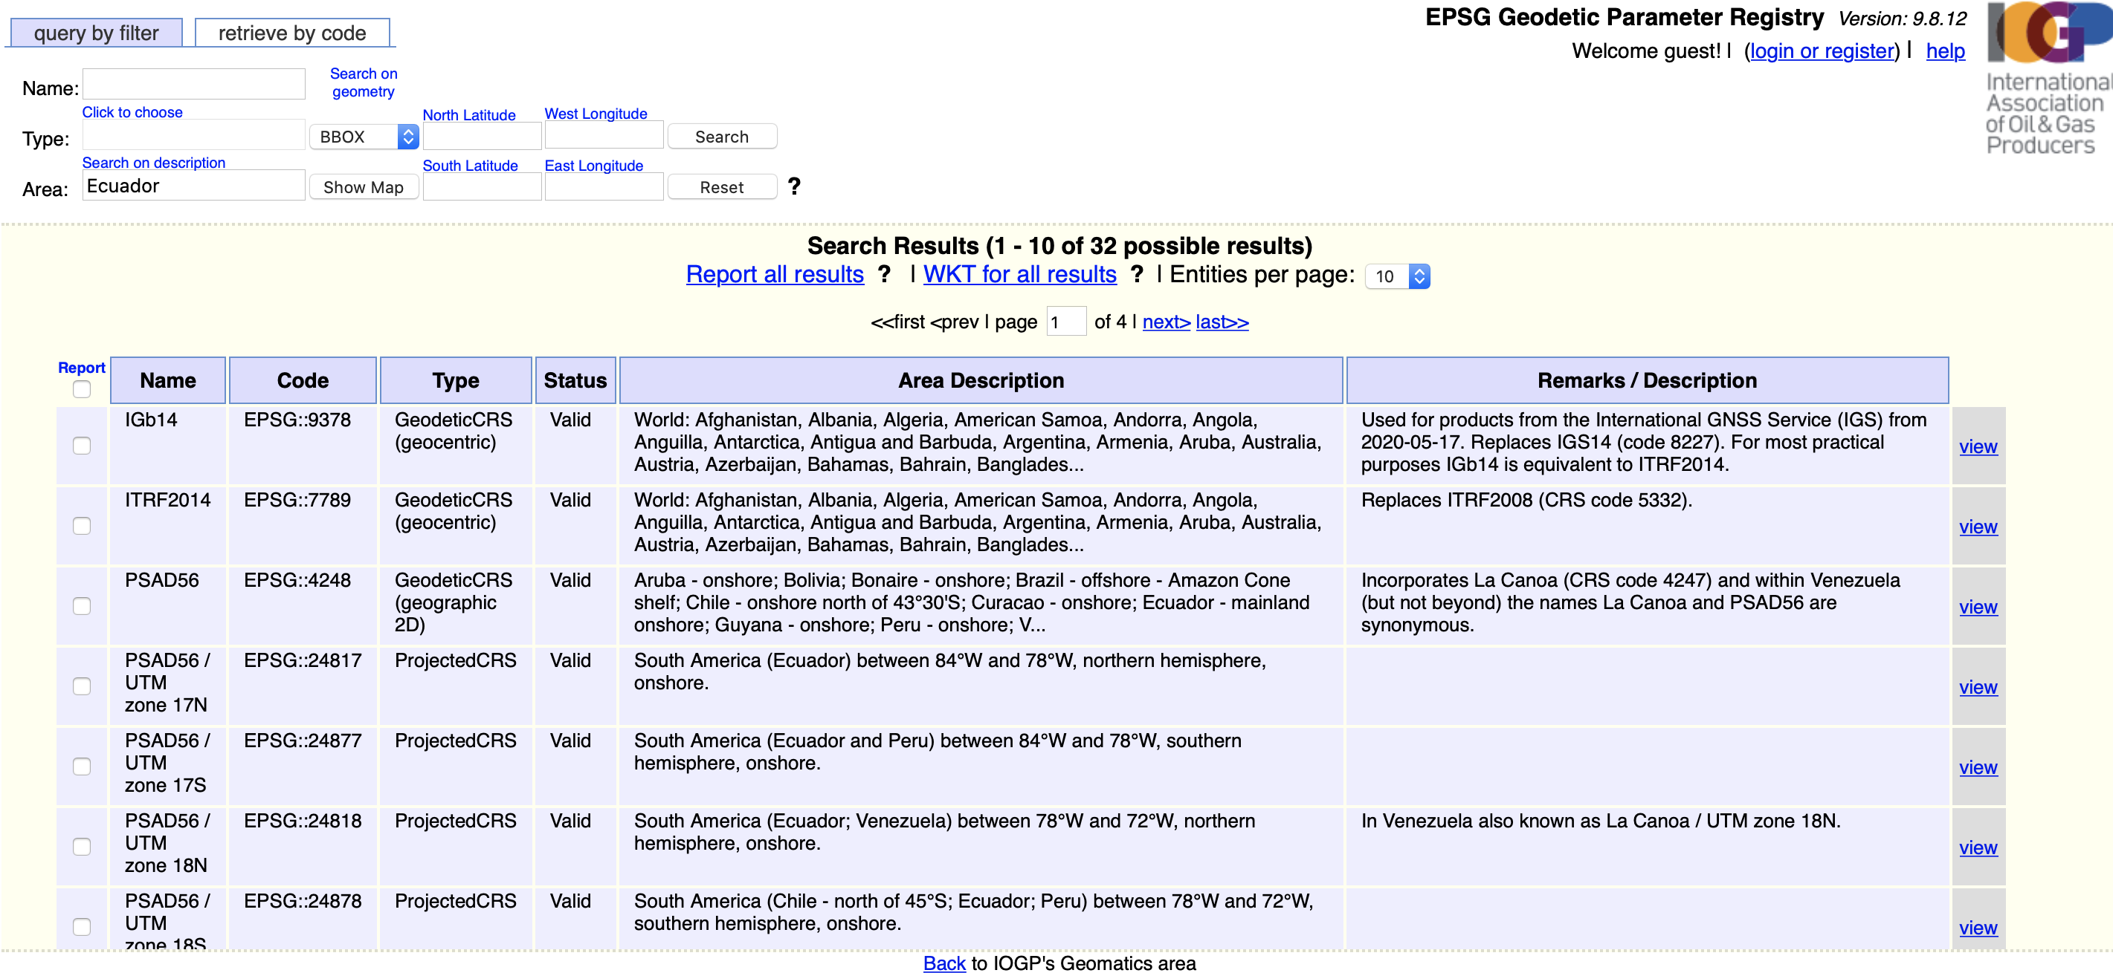
We want something that’s accurate for our study area
Datum itself isn’t that important – one of the most common is GRS80
We want a Latin American projection system, localized in Ecuador
Image source: EPSG Repository

Slide 35
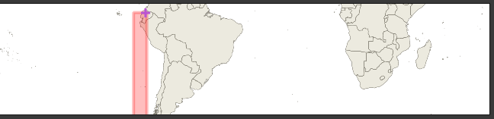
SIRGAS 2000/UTM Zone 17S
We are just in bounds of 1.0m accuracy SIRGAS 2000/17S
EPSG 31977
Note: not the only choice we could make! There are many possibly options
Decision based on locality (always better to fit with a projection suited to your part of the geoid) and widespread use – SIRGAS 2000 a standard CRS for South America
Image source: QGIS Projections Manager

Slide 36
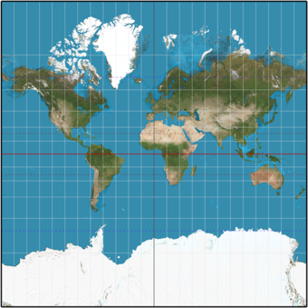
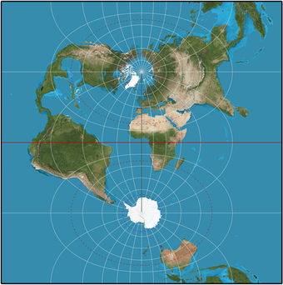
SIRGAS 2000
“The projection is reasonably accurate near the central meridian. Scale at an angular distance of 5° (in longitude) away from the central meridian is less than 0.4% greater than scale at the central meridian, and is about 1.54% at an angular distance of 10°.”
Image and Quote Source: https://en.wikipedia.org/wiki/Transverse_Mercator_projection

Slide 37
Georeferencing

Slide 38
What is Georeferencing?
Assignment of real world coordinates to pixels of an unreferenced raster
Deccan Traps example from last time
Requires manually fixing “control points” between map and real spatial objects
BEST CONTROL POINTS:
Riverheads
Clear topographic features (ridge, unique landform, etc.)
Intersections of lat/long grid lines
Edge of map area
BAD CONTROL POINTS: Town names
Choice of transformation….
Thorough walk through: https://www.qgistutorials.com/en/docs/3/georeferencing_basics.html

Slide 39
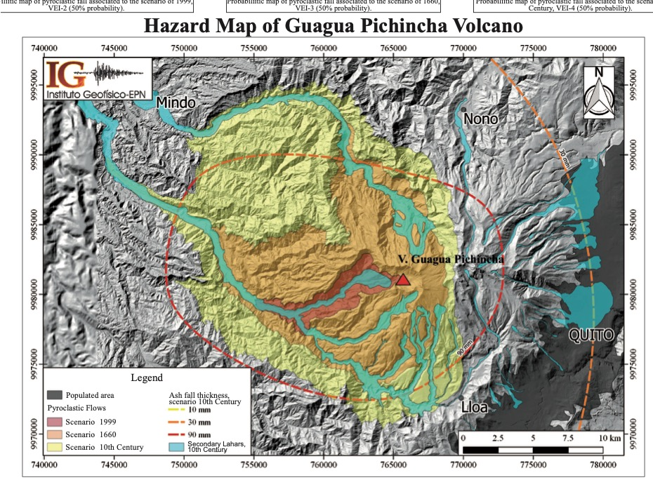
Map Source: Telenchana et al. (2019): The New Volcanic Hazard Map of Guagua Pichincha Volcano, Third Edition 2019.
https://www.researchgate.net/publication/336104232_The_New_Volcanic_Hazard_Map_of_Guagua_Pichincha_Volcano_Third_Edition_2019

Slide 40
Tracing Basemap

Slide 41
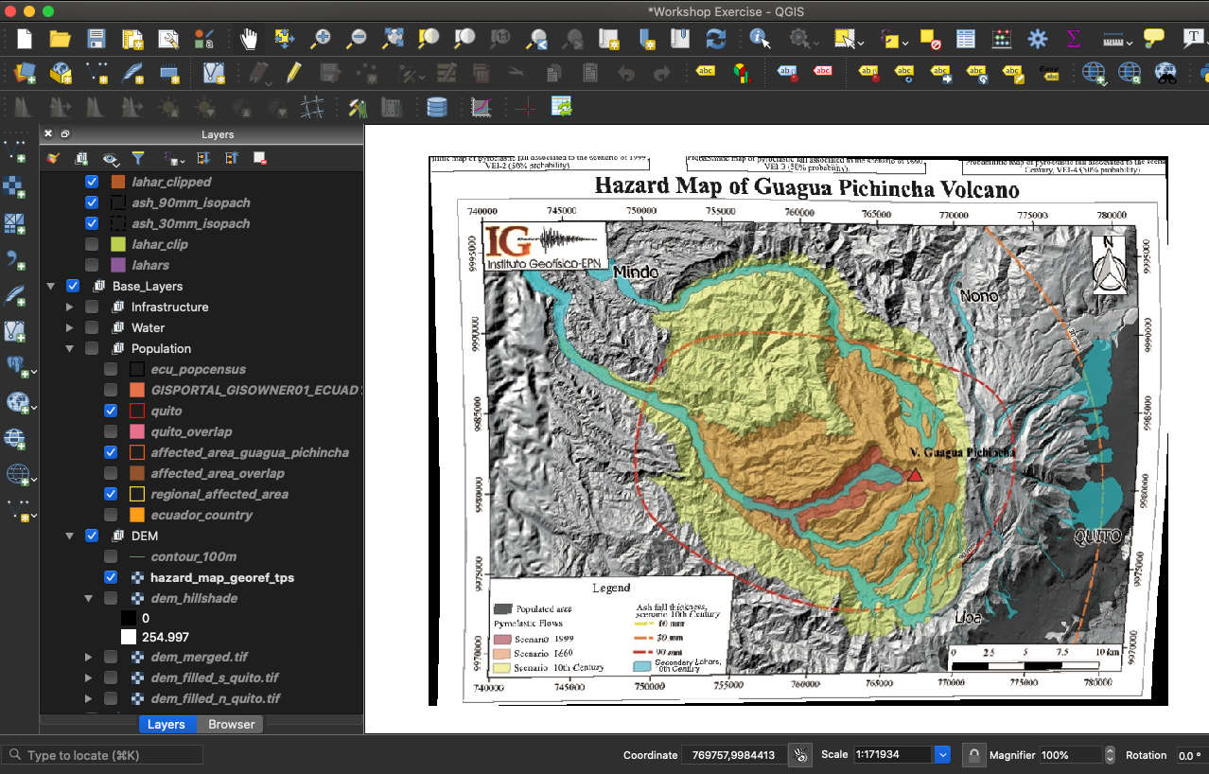
Creating New Features
Need to first define layer, then manually add points
Note: image processing algorithm can do some of this work
NEXT account for tracing errors: I fixed my scale of tracing, so I know my error is between 10-50 m (USGS)
ALWAYS KEEP SCALE IN MINDS
We also have to account for distortion from georeferencing

Slide 42
Errors

Slide 43
Error Sources
Attribute data
Unfortunately don’t know this at this time – what is the error in a census?
Hazard Map doesn’t given an indication of error either, but doubtless there is some
Projection error (usually quite small)
Estimated Error of SIRGAS is 1.0m (see EPSG website)
Georeferencing error: Error report suggests < 1 m
However, given we didn’t know starting PCS, this is likely an underestimate – we can see some notable distortion
Anything derived from basemap carries this georeferencing error forward
Base map error: USGS defines between 10-50m error in a map drawn between 1:20000-1:100000 scale
We drew between these scales, so let's take the high end (50 m)

Slide 44
Analysis

Slide 45
Answering our question
How many people are at risk of exposure to the different eruptive products of Guagua Pichincha Quito?
Attribute Manipulation: How many people live in a canton?
Define provinces affected by ash and lahars
Selection, Dissolving
Spatial Statistics: How many people in total?
Exporting Statistics
Areal statistics: % Overlap in Lahars and Quito
Proportion of population vulnerable to lahars

Slide 46
Defining Key Terms
Spatial Statistics/Areal Statistics: Statistical + Analytical methods that add geographic space as a mathematical variable.
Here, we are using simple statistical measures like the mean to describe a spatial feature: the extent to which a modeled volcanic hazard will affect Quito.
We will see next week how spatial statistics defines a unique and powerful branch of mathematics all its own.
Geoprocessing: Main spatial analysis workflows for topological problems. See next few slides for examples (http://webhelp.esri.com/arcgisdesktop/9.2/index.cfm?TopicName=An_overview_of_commonly_used_tools)

Slide 47
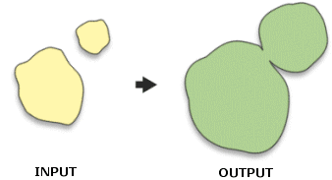
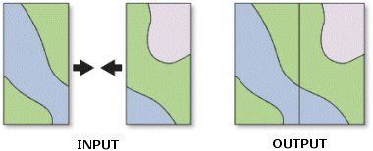
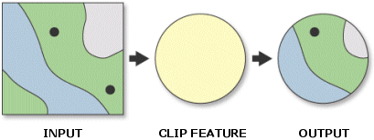
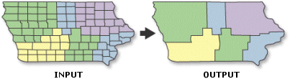
Geoprocessing Tools
Note that raster files can be subjected to similar operations, they just get applied slightly differently.
Buffer
Append
Clip
Dissolve

Slide 48
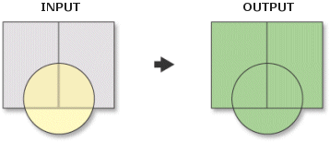
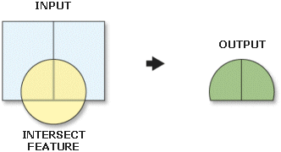
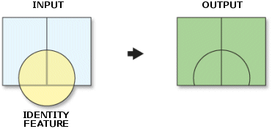
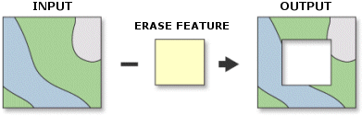
Geoprocessing Tools
Note that raster files can be subjected to similar operations, they just get applied slightly differently.
Union
Intersect
Identity
Erase

Slide 49
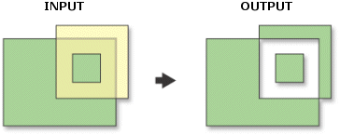
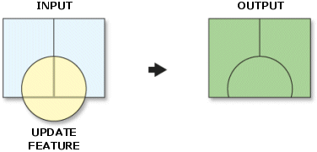
Geoprocessing Tools
Note that raster files can be subjected to similar operations, they just get applied slightly differently.
Symmetrical Difference
Update

Slide 50
Symbolizing

Slide 51
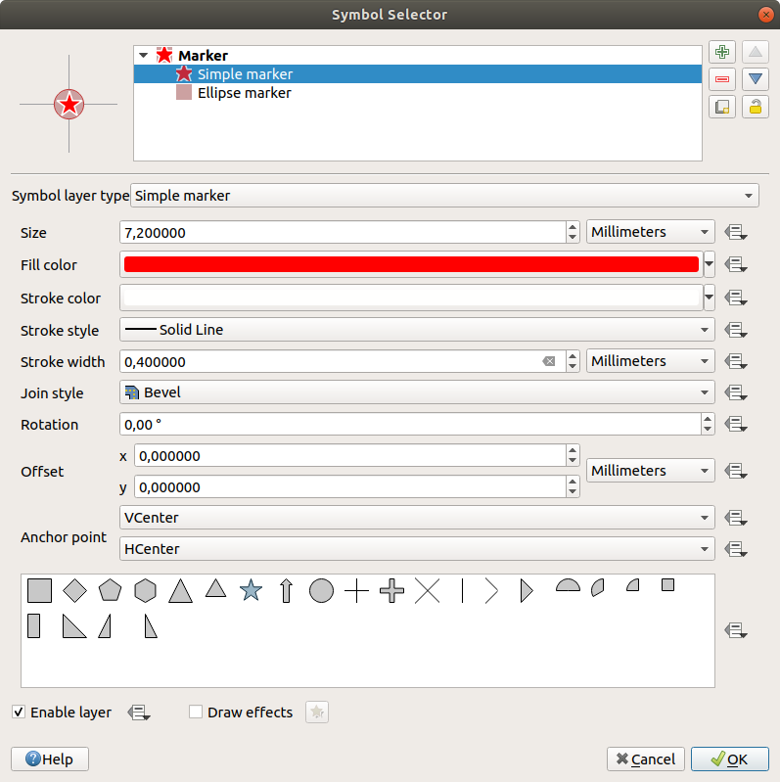
Making the Data Look Nice
Do some of this formatting before editing the layout
Symbology:
Making topography data look nice
Stylizing vector data
Fill
Stroke
Transparency
Label Making
Easy Custom Labels + Memory

Slide 52
Layout Management

Slide 53
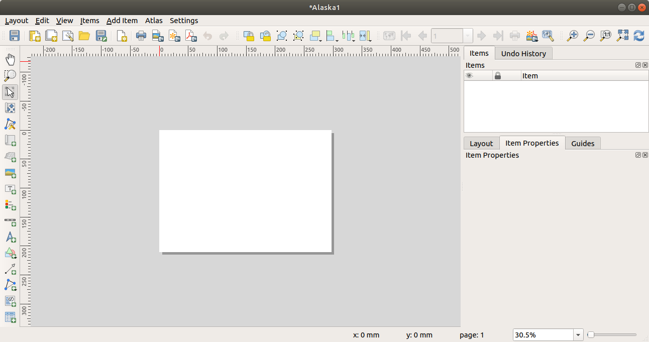
Layout
Elements we want:
Main Map
Regional Inset Map
Legend
North Arrow
Scale bar
Grid
Labels for important features
Text box summarizing findings
Things to keep in mind:
Map Scale
Locking of display
Legend items
Aesthetic value

Slide 54
Resources for further learning

Slide 55


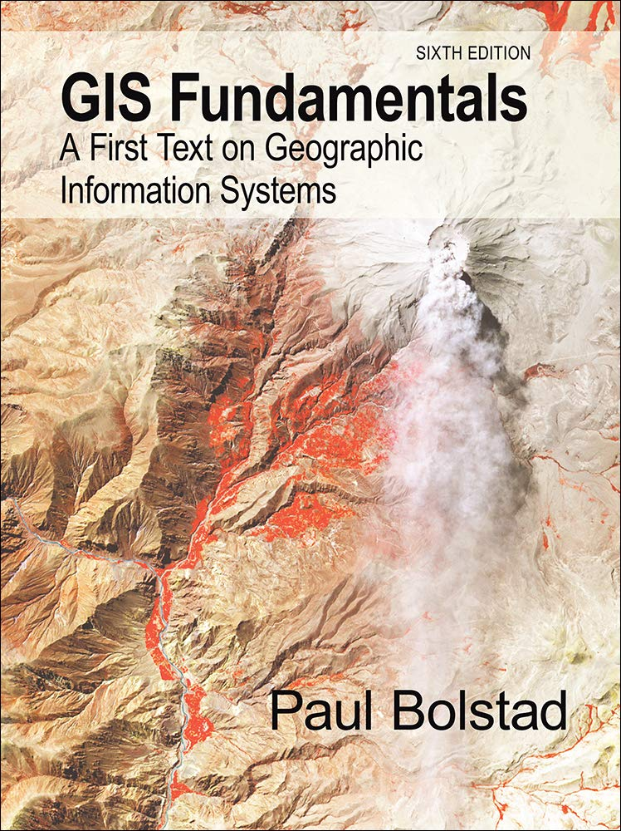

Textbooks
Geospatial Analysis, de Smith (2020): https://www.spatialanalysisonline.com/HTML/index.html
Principles of Geographic Information Systems, Huisman & de By: https://webapps.itc.utwente.nl/librarywww/papers_2009/general/principlesgis.pdf

Slide 56
For your practical Thursday…
Review material available on Moodle/GitHub
Familiarize yourself with Practical 1 PDF Guide
Import the data from Moodle (or GitHub) and make sure you can load it into QGIS in the Galson Lab
Complete the Lecture 1 Feedback form: https://forms.gle/kBUg57SAoxVz6x7G7
OPTIONAL: Watch Supplemental Lectures
S1: Why GIS? Why we care/uses of GIS
S2: Coordinate Systems and Projections
S3: Tour of QGIS interface*
S4: Finding Data
OPTIONAL: Try to Install QGIS on your computer (instructions are in practical 1 guide)

Slide 57
Post-Lecture Feedback
After this lecture, please follow this link to provide me with some feedback on my teaching style: https://forms.gle/mrGg9RGphPjbMqCw6
My goal is to consistently improve this course. Your feedback allows me to improve this course for future students

